Slide 1
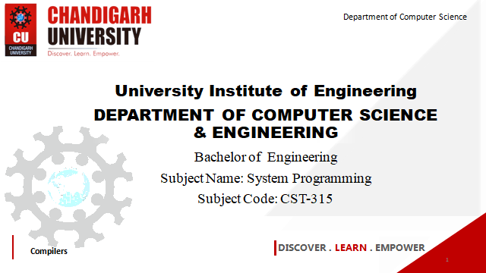

Department of Computer Science
University Institute of Engineering
DEPARTMENT OF COMPUTER SCIENCE & ENGINEERING
Bachelor of Engineering
Subject Name: System Programming
Subject Code: CST-281
Compilers
DISCOVER . LEARN . EMPOWER

Slide 2
Chapter-1.3 Macro
Department of computer Science
Macro Parameters
Design of a Macro Assembler,
Features of Macro Processors
Functions of a Macro Processor
Basic Tasks of a Macro Processor
Design Issues of macro processors

Slide 3
Macro Parameters

Slide 4
Macro parameters enable you to pass values into the macro at macro invocation, and set default values for macro variables within the macro definition
TYPES OF MACRO PARAMETERS:
POSITIONAL
KEYWORD.
DEFAULT
MIXED

Slide 5
POSITIONAL PARAMETERS: - You can use positional parameters to assign values based on their position in the macro definition and at invocation.
The order that you use to specify the values must match the order in which they are listed in the %MACRO statement.
When specifying multiple positional parameters, use a comma to separate the parameters.
If you do not pass a value to the macro when it is invoked, a null value is assigned to the macro variable specified in the %MACRO statement.

Slide 6
Parameter Substitution -- Example
Source
STRG MACRO &a1, &a2, &a3
STA &a1
STB &a2
STX &a3
MEND
.
STRG DATA1, DATA2, DATA3
.
STRG DATA4, DATA5, DATA6
.
.

Slide 7
Parameter Substitution -- Example
Source
STRG MACRO &a1, &a2, &a3
STA &a1
STB &a2
STX &a3
MEND
.
STRG DATA1, DATA2, DATA3
.
.
.

Slide 8
Parameter Substitution -- Example
Source
STRG MACRO &a1, &a2, &a3
STA &a1
STB &a2
STX &a3
MEND
.
STRG DATA1, DATA2, DATA3
.
STRG DATA4, DATA5, DATA6
.
.
Expanded souce
.
.
.
STA DATA1
STB DATA2
STX DATA3
.
STA DATA4
STB DATA5
STX DATA6
.
{
{

Slide 9
2. KEYWORD PARAMETERS: -
When you assign values using keyword parameters, you must include an equal sign after the macro variable name.
The benefit of using keyword parameters is the ability to give the macro variables a default value within the macro definition

Slide 10
Keyword Parameter
Source
STRG MACRO &a1 =, &a2= , &a3 =
STA &a1
STB &a2
STX &a3
MEND
.
STRG &a3=DATA1, &a2=DATA2, &a1=DATA3
.
.

Slide 11
3. DEFAULT PARAMETERS: -
The benefit of using keyword parameters is the ability to give the macro variables a default value within the macro definition

Slide 12
Default Parameter
Source
STRG MACRO &a1 = XYZ , &a2= ABC
STA &a1
STB &a2
STX &a3
MEND
.
STRG &a1=DATA1, &a2=DATA2
STRG &a1=DATA1
STRG

Slide 13
4. MIXED PARAMETERS: -

Slide 14
MIXED Parameter
Source
STRG MACRO &a1 = XYZ , &a2=
STA &a1
STB &a2
STX &a3
MEND
.
STRG &a1=DATA1, &a2=DATA2
STRG &a2=DATA1

Slide 15
Macro Assembler
An assembler that brings high-level language features to assembly language programming. It translates a single multi-argument source line code into a sequence of machine instructions.
A macro assembler is able to generate a program segment, which is defined by a macro, when the name of the macro appears as an opcode in a program. The macro assembler is still capable of regular assembler functioning, generating a machine instruction for each line of assembly language code; but like a compiler, it can generate many machine instructions from one line of source code. Its instruction set can be expanded to include new mnemonics, which generate these program segments of machine code.

Slide 16
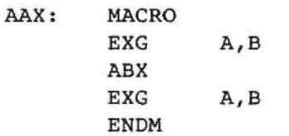

The following discussion of how a macro works will show how this can be done.
A frequently used program segment can be written just once, in the macro definition at the beginning of a program.
For example, the macro
allows the programmer to use the single mnemonic A AX to generate the sequence.
The assembler will insert this sequence each time the macro AAX is written in the assembler source code. If the mnemonic AAX is used ten times in the program, the three instructions above will be inserted into the program each time the mnemonic AAX is used.

Slide 17
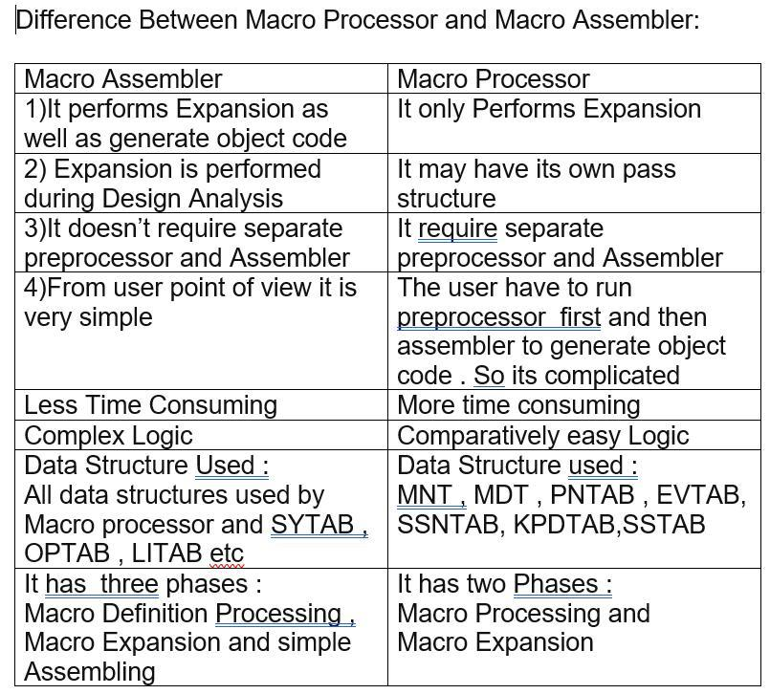

Slide 18
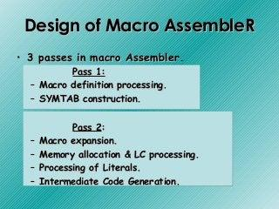

Slide 19
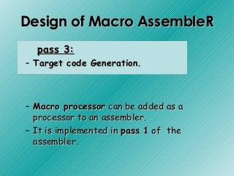
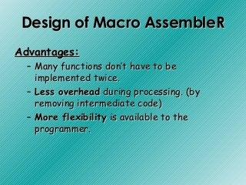

Slide 20
Pass 1
READ
Search
(Pseudo-Op Table)
Pass 2
R
Type?
Search NAMTAB
(Macro Name Table)
MACRO
Define
Process
pseudo-ops
Search
(Machine Op Table)
R
R
MACRO
Expand
Process machine instruction
R
Macro Assembler Flow Chart
R

Slide 21
Disadvantages(Macro assembler):
• Combined pass 1 of the assembler & macro processor may be too large for the program to fit into core of some machine.
Complexity of such program may be overwhelming.

Slide 22
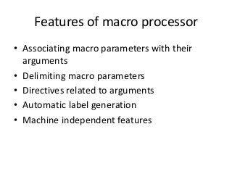

Slide 23
Functions of a Macro Processor
Recognize macro definitions
Save the macro definition
Recognize macro calls
Expand macro calls
Source Code
(with macro)
Macro Processor
Expanded Code
Compiler or Assembler
obj

Slide 24
BASIC Tasks of MACRO PROCESSOR
The fundamental functions common to all macro processors are:
Macro Definition
Macro Invocation
Macro Expansion
(Already covered in PPT 1.3.1)

Slide 25
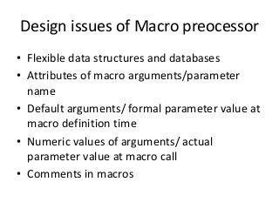

Slide 26
References
John J Donovan Systems Programming Ebook Wordpress (pdflife.one)
[PDF] Systems Programming and Operating Systems by Dhamdhere - Free Download PDF (dlscrib.com)

Slide 27

THANK YOU

